Slide 1
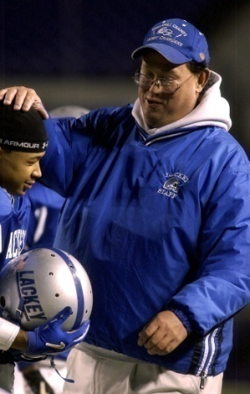
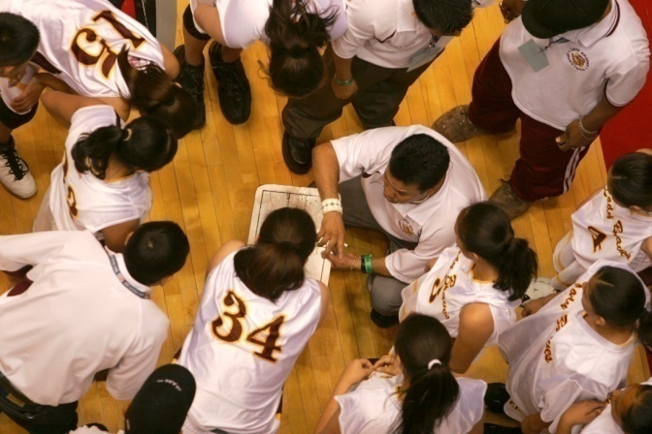
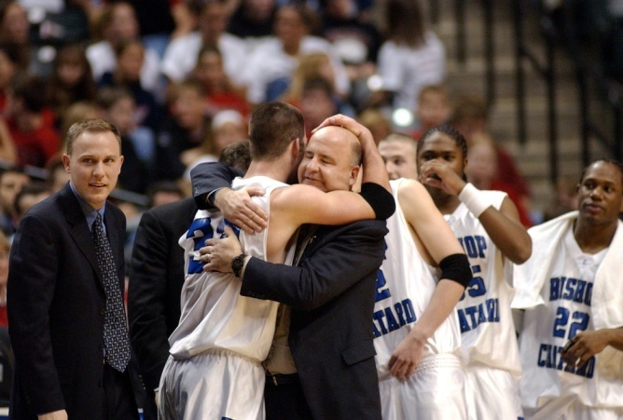
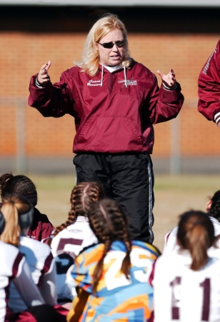
MIC3 – Military Interstate Children’s Compact Commission
OCTOBER 16-18, 2018
CLEVELAND, OH

Slide 2
Welcome and Introductions
Davis A. Whitfield, MA
NFHS
Chief Operating Officer
North Carolina High School Athletic Association (NCHSAA)
Commissioner
Atlantic Coast Conference (ACC)
Associate Commissioner
Wake Forest University (WFU)
Assistant Athletics Director

Slide 3
About the nfhs

Slide 4
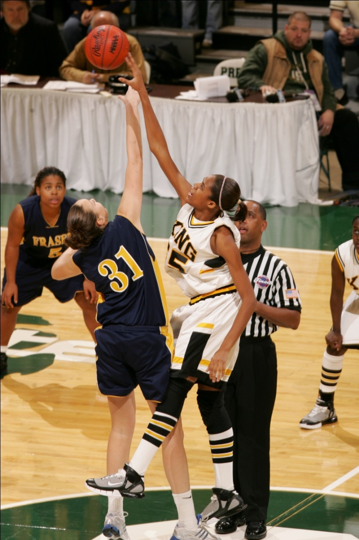
National Federation of state High School Associations
NFHS
Located in Indianapolis, IN
Established in 1920
40-Person staff
National leadership organization for high school sports and fine arts activities
Writes playing rules for 17 boys and girl sports at the high school level
National authority on interscholastic activity programs
Notes:
About the National Federation of State High School Associations (NFHS) cont:
The NFHS, based in Indianapolis, Indiana, is the national leadership organization for high school sports and fine arts activities. Since 1920, the NFHS has led the development of education-based interscholastic sports and fine arts activities that help students succeed in their lives. The NFHS sets direction for the future by building awareness and support, improving the participation experience, establishing consistent standards and Rules for competition, and helping those who oversee high school sports and activities. The NFHS writes playing Rules for 17 sports for boys and girls at the high school level. Through its 50 member state associations and the District of Columbia, the NFHS reaches nearly 19,000 high schools and 11 million participants in high school activity programs, including more than 7.6 million in high school sports.

Slide 5
National Federation of State High School Associations
VISION
The National Federation of State High School Associations (NFHS) is the national leader for education-based high school athletics and activities, which prepare tomorrow’s leaders for the next level of life through innovative programs, healthy participation, achievement, and development of positive relationships

Slide 6
National Federation of State High School Associations
MISSION
The National Federation of State High School Associations (NFHS) serves its members by providing leadership for the administration of education-based high school athletics and activities through the writing of playing rules that emphasize health and safety, educational programs that develop leaders, and administrative support to increase participation opportunities and promote sportsmanship.

Slide 7
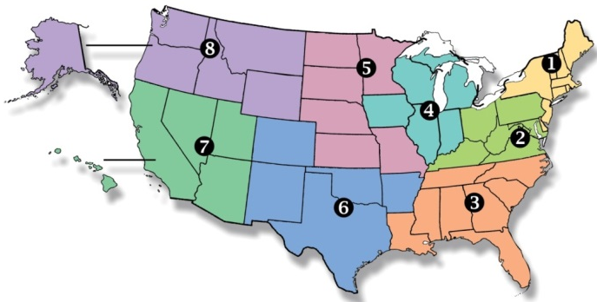
National Federation of state High School Associations
Membership = 50 member state associations and D.C.
NFHS reaches 19,000 plus high schools and almost 12 million participants in high school activity programs, including more than 7.8 million in high school sports.
Notes:
About the National Federation of State High School Associations (NFHS) cont:
The NFHS, based in Indianapolis, Indiana, is the national leadership organization for high school sports and fine arts activities. Since 1920, the NFHS has led the development of education-based interscholastic sports and fine arts activities that help students succeed in their lives. The NFHS sets direction for the future by building awareness and support, improving the participation experience, establishing consistent standards and Rules for competition, and helping those who oversee high school sports and activities. The NFHS writes playing Rules for 17 sports for boys and girls at the high school level. Through its 50 member state associations and the District of Columbia, the NFHS reaches nearly 19,000 high schools and 11 million participants in high school activity programs, including almost 7.5 million in high school sports.

Slide 8
National Federation of state High School Associations
Each State Governs Athletics and Activities
Eligibility
Age
Academics
Residence
Sports Seasons
School of Residence
Opportunities to Participate
Transition
Notes:
About the National Federation of State High School Associations (NFHS) cont:
The NFHS, based in Indianapolis, Indiana, is the national leadership organization for high school sports and fine arts activities. Since 1920, the NFHS has led the development of education-based interscholastic sports and fine arts activities that help students succeed in their lives. The NFHS sets direction for the future by building awareness and support, improving the participation experience, establishing consistent standards and Rules for competition, and helping those who oversee high school sports and activities. The NFHS writes playing Rules for 17 sports for boys and girls at the high school level. Through its 50 member state associations and the District of Columbia, the NFHS reaches nearly 19,000 high schools and 11 million participants in high school activity programs, including almost 7.5 million in high school sports.

Slide 9
National Federation of state High School Associations
Nine – State Associations serve on their respective State Council
North Carolina
Fort Bragg
Seymour Johnson
Cherry Point
Notes:
About the National Federation of State High School Associations (NFHS) cont:
The NFHS, based in Indianapolis, Indiana, is the national leadership organization for high school sports and fine arts activities. Since 1920, the NFHS has led the development of education-based interscholastic sports and fine arts activities that help students succeed in their lives. The NFHS sets direction for the future by building awareness and support, improving the participation experience, establishing consistent standards and Rules for competition, and helping those who oversee high school sports and activities. The NFHS writes playing Rules for 17 sports for boys and girls at the high school level. Through its 50 member state associations and the District of Columbia, the NFHS reaches nearly 19,000 high schools and 11 million participants in high school activity programs, including almost 7.5 million in high school sports.

Slide 10
Contact Information
Davis Whitfield, Chief Operating Officer
National Federation of State High School Associations
PO Box 690
Indianapolis, Indiana 46206
Office Phone: 317.822.5758
E-mail: dwhitfield@nfhs.org
Website: www.nfhs.org
Education Website: www.nfhslearn.com
Notes:
Contact Information:
SOCCER EDITOR:
Mark Koski, CMAA, Director of Sports, Events and Development
Soccer Rules Editor and National Interpreter
National Federation of State High School Associations
PO Box 690
Indianapolis, Indiana 46206
Office Phone: (317) 972-6900
E-mail: mkoski@nfhs.org
Website: www.nfhs.org

